Slide 1

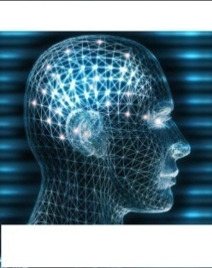


Networks dynamics of the brain and the influence of the epileptic seizure onset zone
Neuromedical Control Systems Lab
Sri Sarma
Loyola April 2016

Slide 2

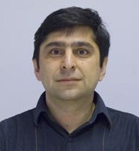
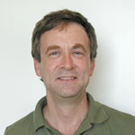
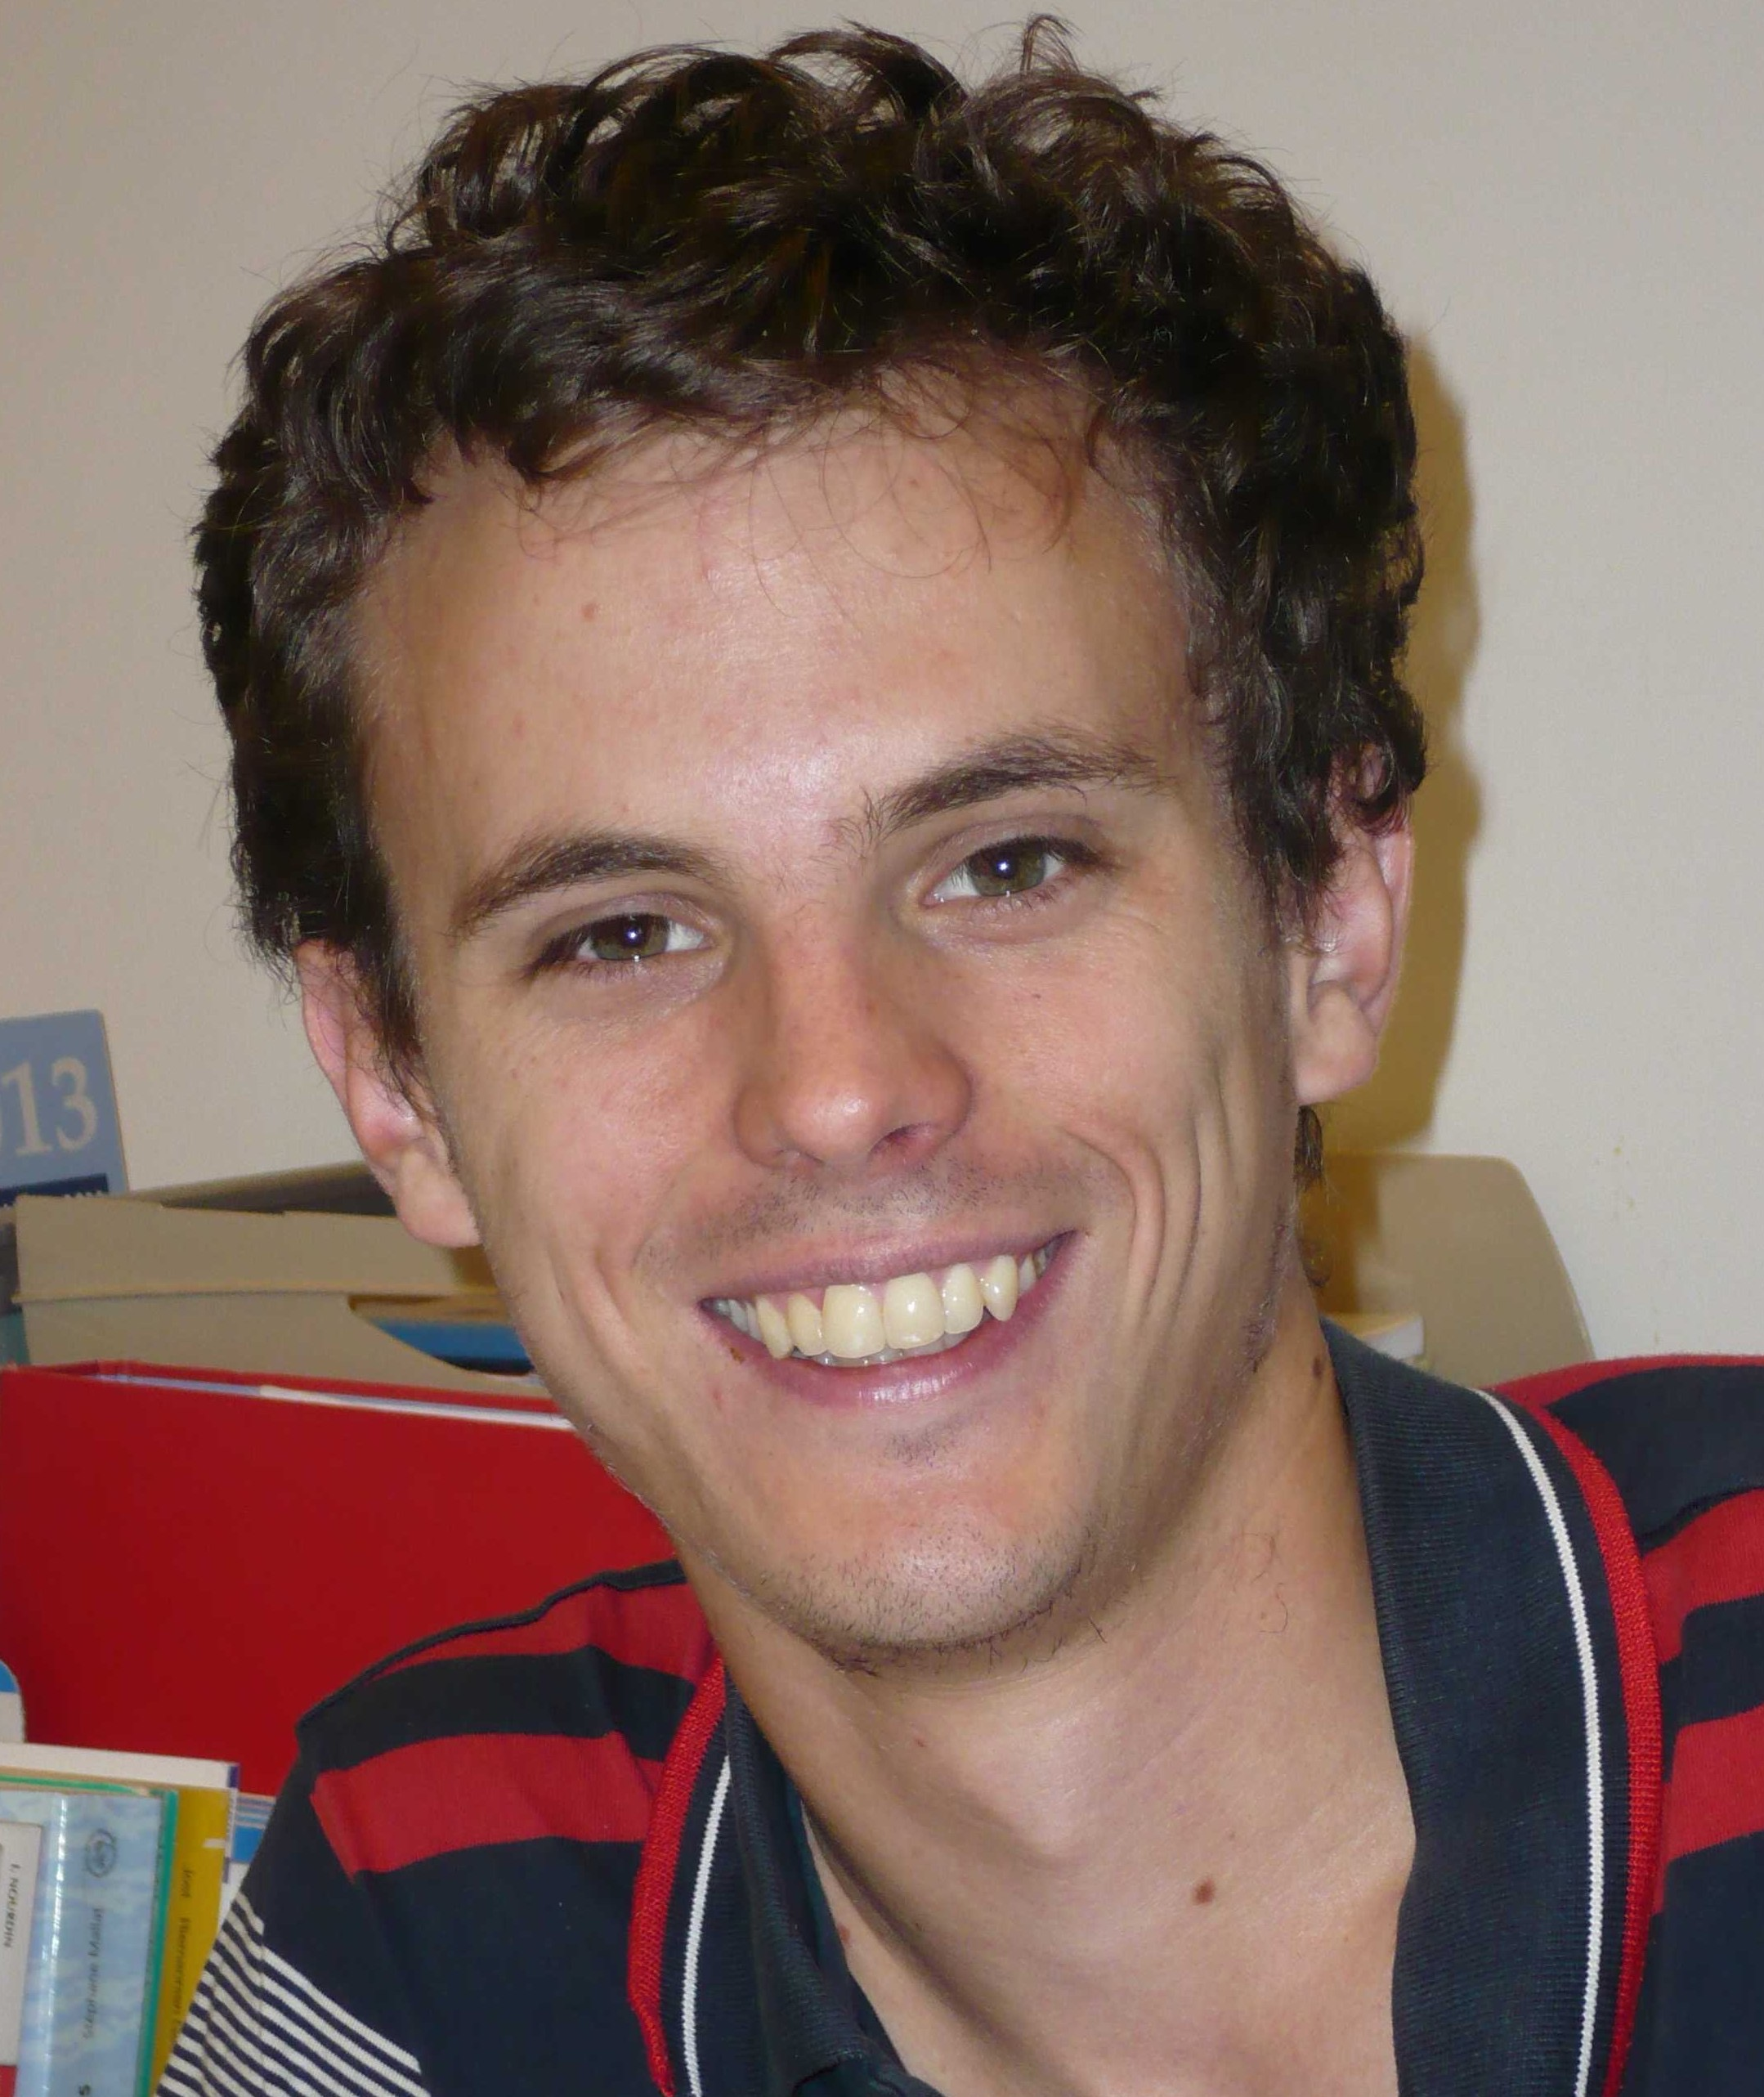
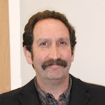

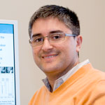
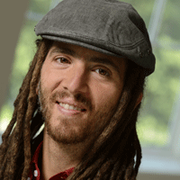
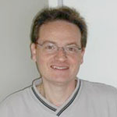
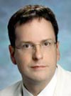
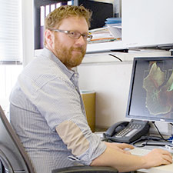
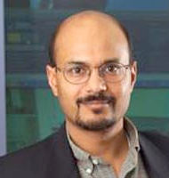
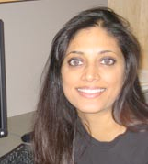
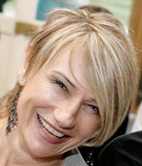
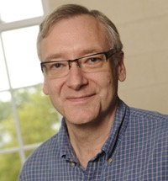
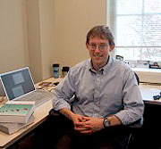
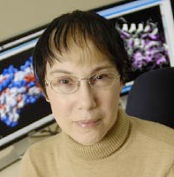
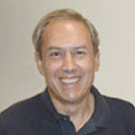
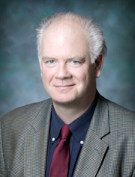
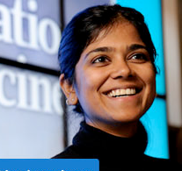
Who we Are
Computational Anatomical Medicine
Ardekani
Barta
Charon
Miller
Ratnanather
Vidal
Vogelstein
Younes
Computational Physiological Medicine
Mac
Gabhann
Anderson
Mittal
Sarma
Trayanova
Winslow
Computational Molecular Medicine
Computational Healthcare
Bader
Karchin
Mac
Gabhann
Epstein
Saria
Geman

Slide 3
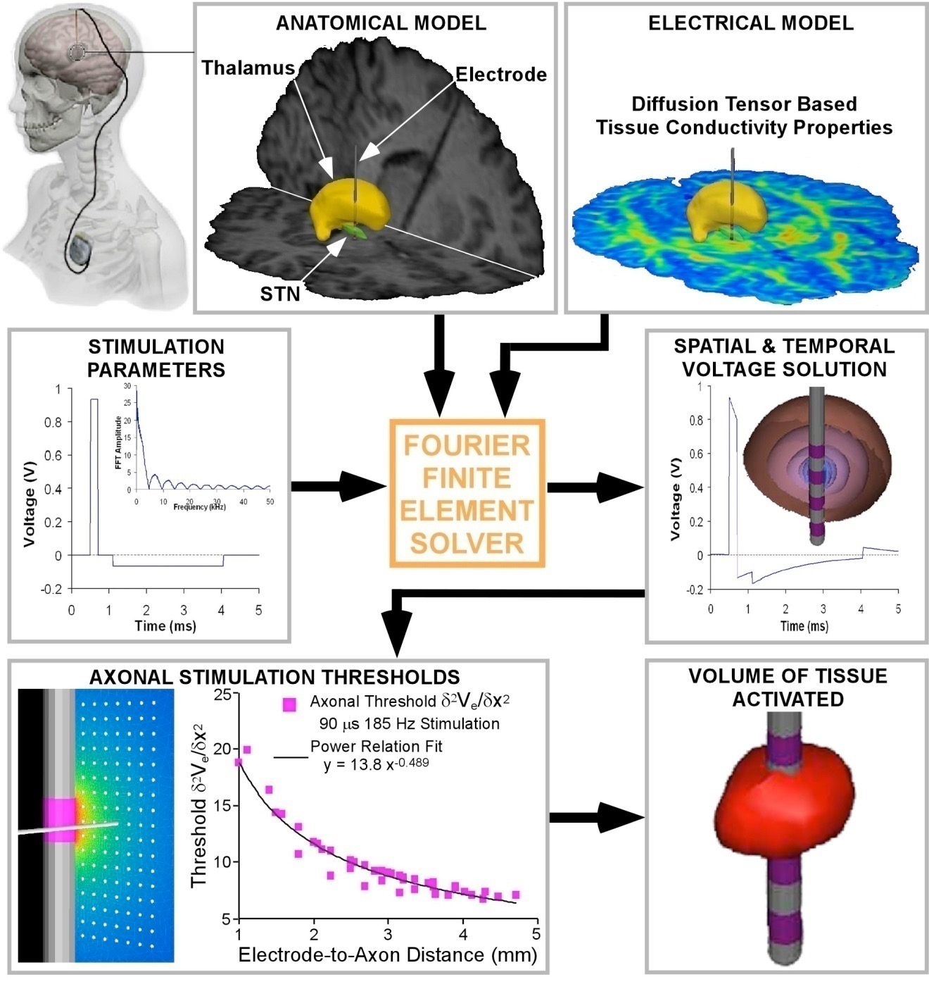
What is computational medicine?
Develop mechanistic & statistical models of disease
Personalize them using patient data
Apply them to deliver precision medicine tailored to the needs of the individual

Slide 4
Computational Anatomical Medicine
Ardekani
Barta
Charon
Miller
Ratnanather
Vidal
Vogelstein
Younes
Computational Physiological Medicine
Mac
Gabhann
Anderson
Mittal
Sarma
Trayanova
Winslow
Computational Molecular Medicine
Computational Healthcare
Bader
Karchin
Mac
Gabhann
Epstein
Saria
Geman

Slide 5
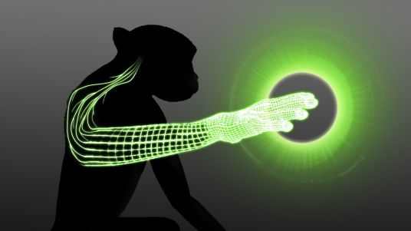
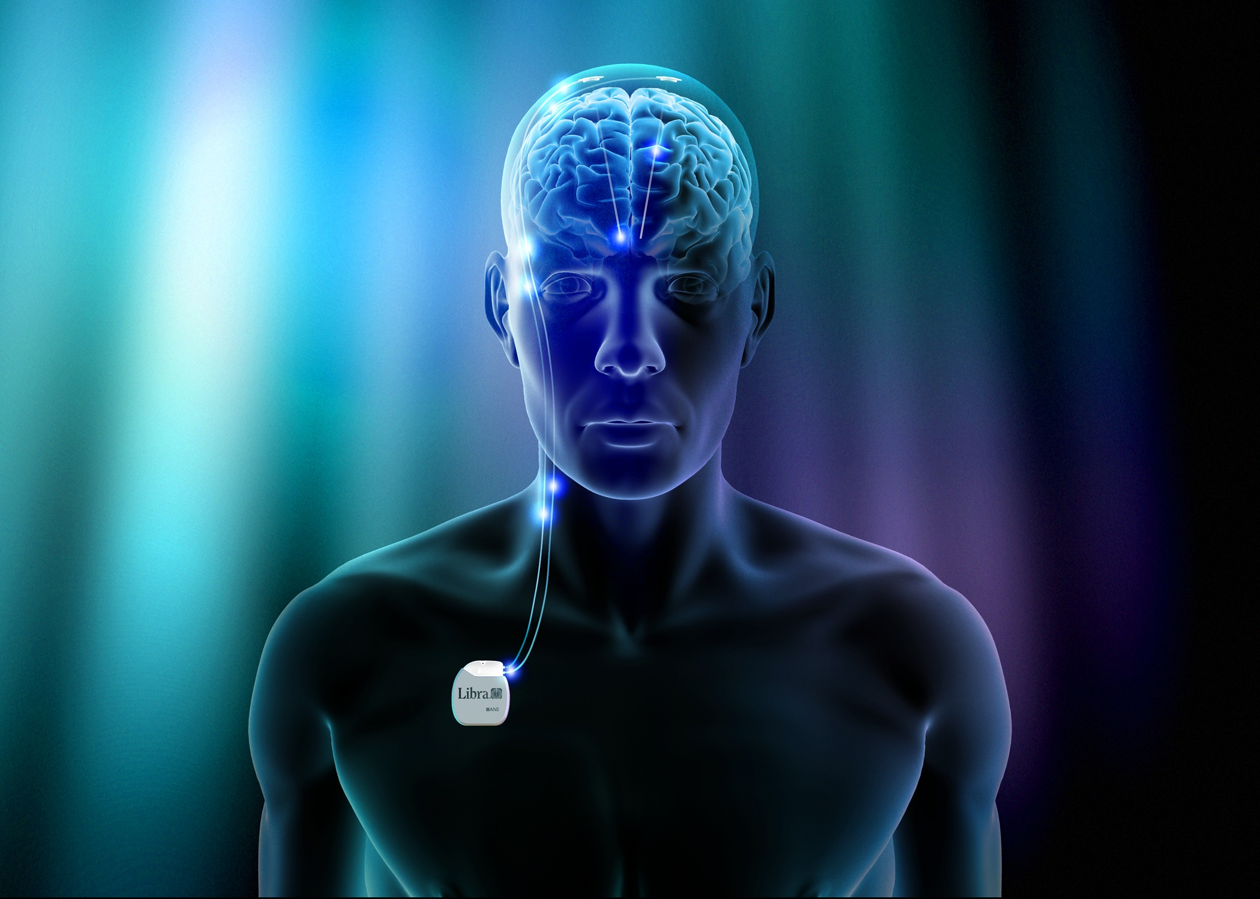
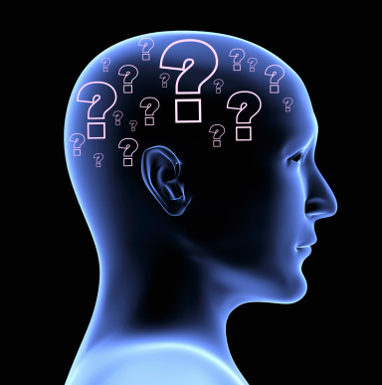
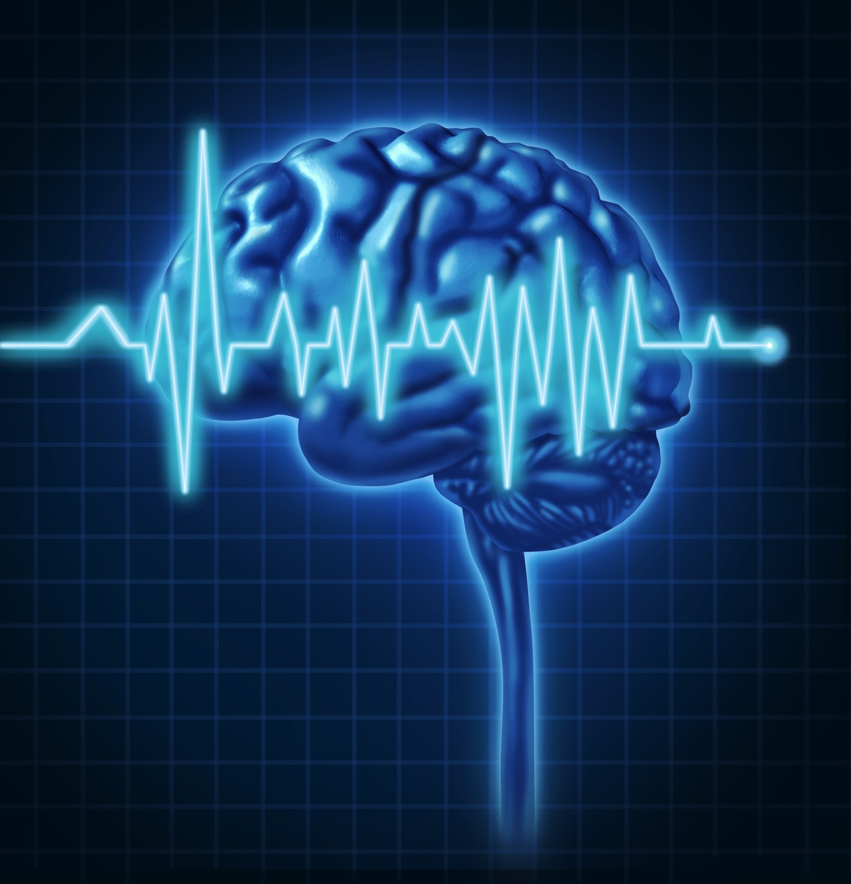
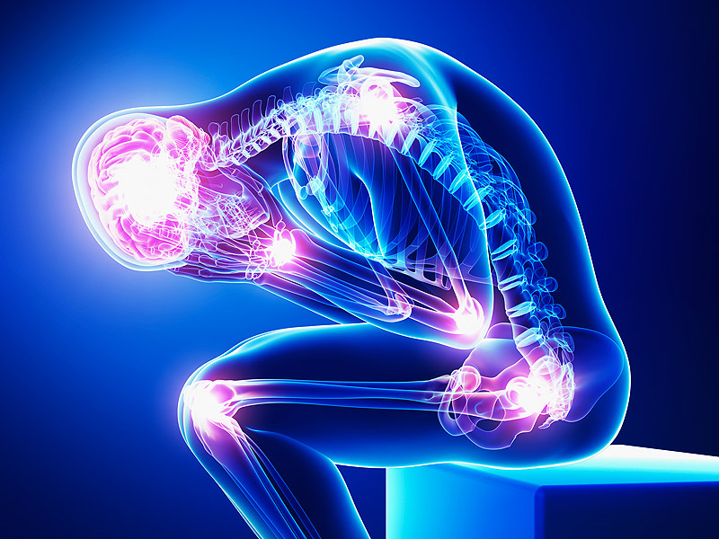

Research thrusts
brain machine interface
parkinson’s disease
decision making
epilepsy
chronic pain
sleep

Slide 6
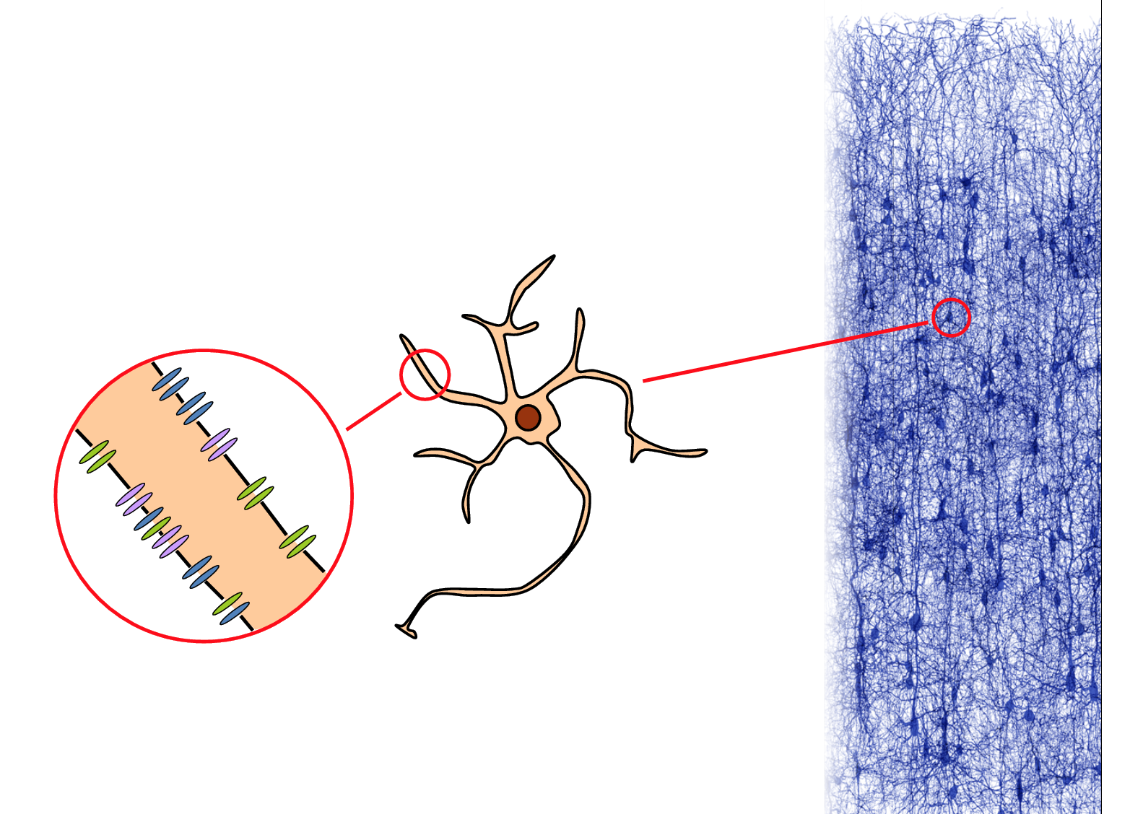
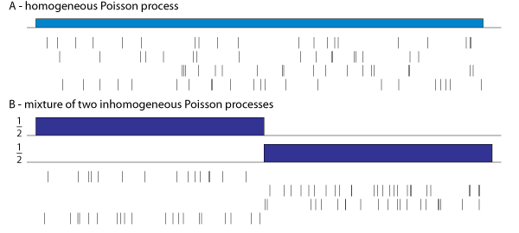
Approaches
Mechanistic Models
describe interacting mechanisms leading to qualitative patterns of neural spiking
complicated coupled nonlinear ODEs, lots of unknown parameters
exploit systems theory
Statistical Models
Predict timing of spikes as a function of the biological/behavioral signals represented in the brain
treat the neuron as a black box, looking for associations rather than mechanisms

Slide 7
epilepsy

Slide 8
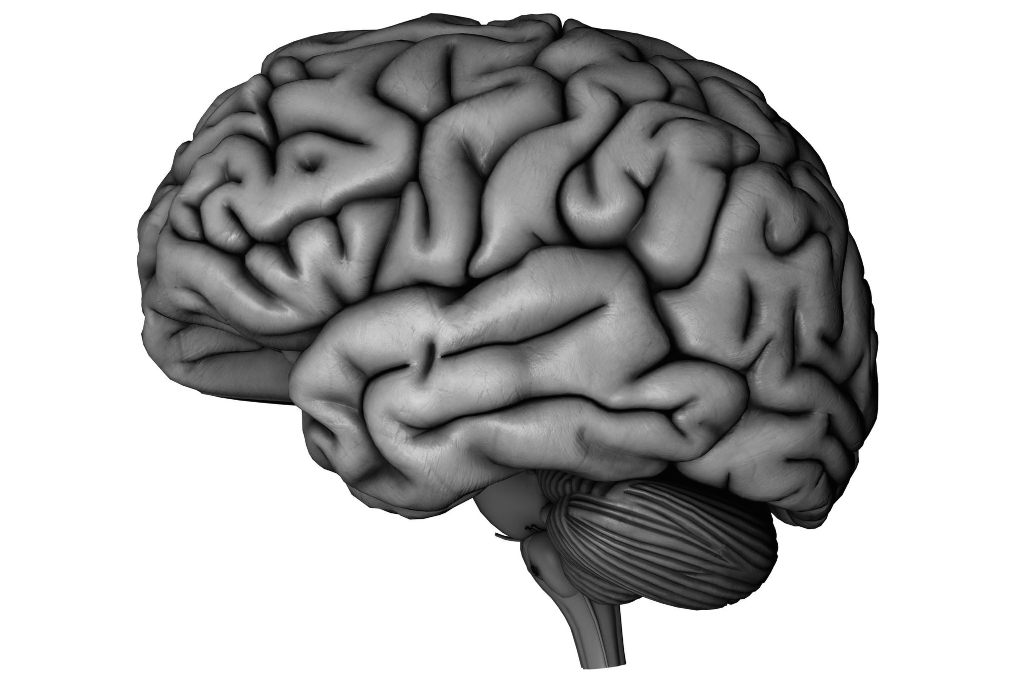

Intractractable focal epilepsy
20M
people have intractable epilepsy
10M
Have focal intractable epilepsy (450k in US) i.e., seizure starts in the seizure onset zone (SOZ)
Surgical Resection
Neuro-Stimulation
30-70%
Have successful surgical outcomes
2%
of candidates elect surgery requiring localizing the EZ

Slide 9
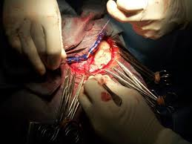
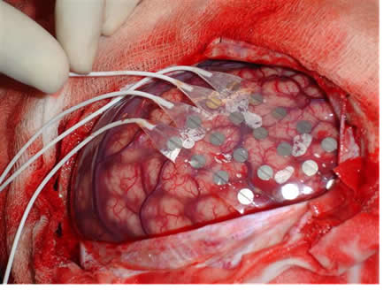
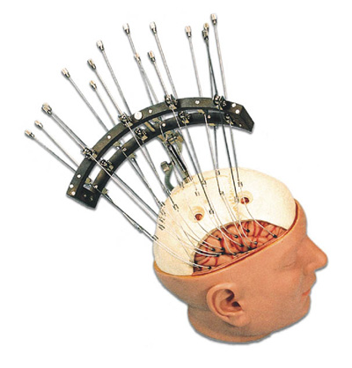
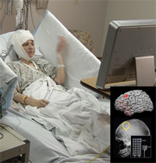
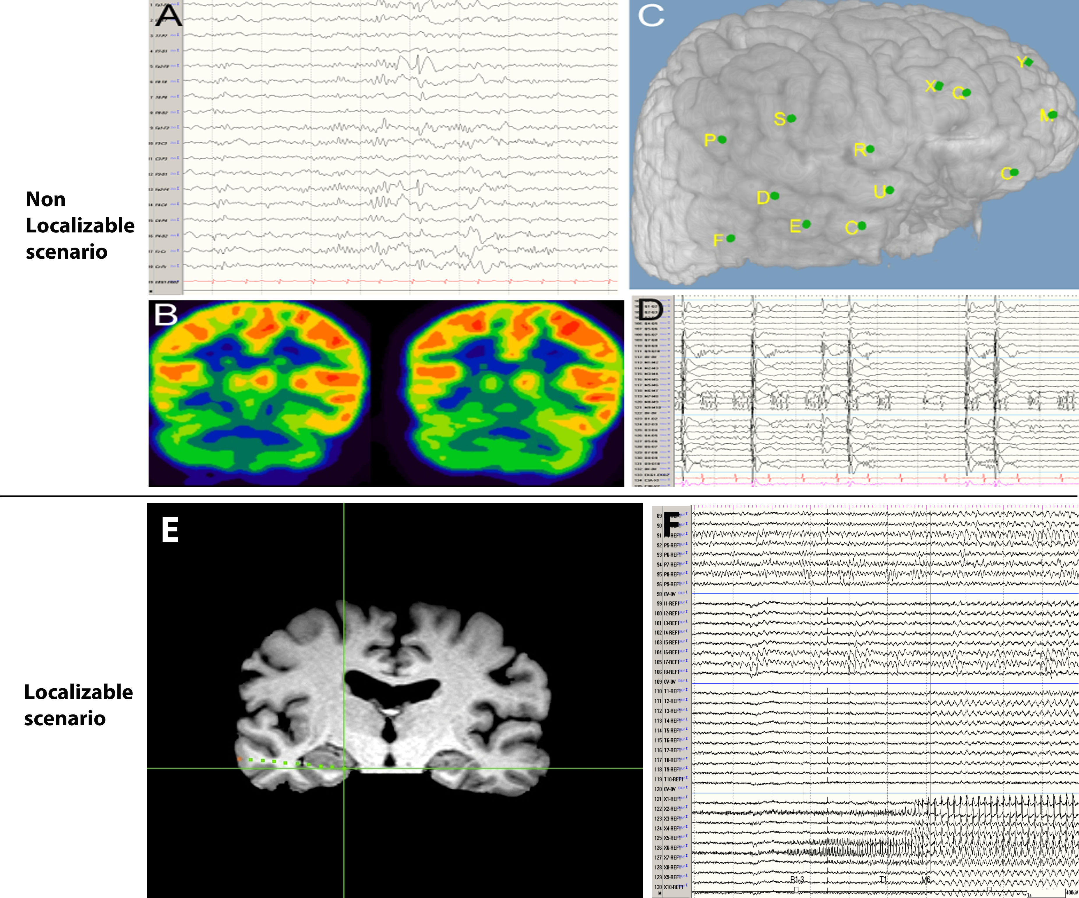
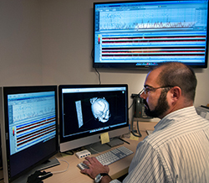
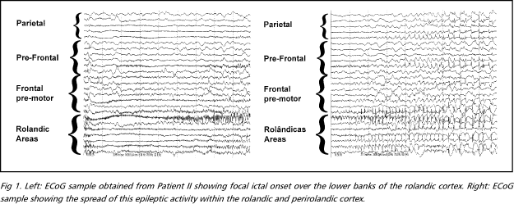
Localization is a highly invasive process
Craniotomy
Electrode Implantation
Monitoring (Days/Weeks)
Clinical Team Attempts to Localize Visually

Slide 10
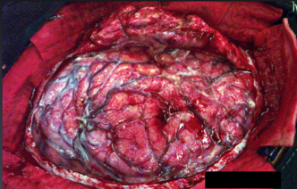
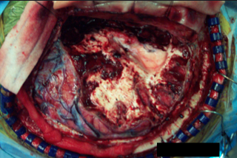
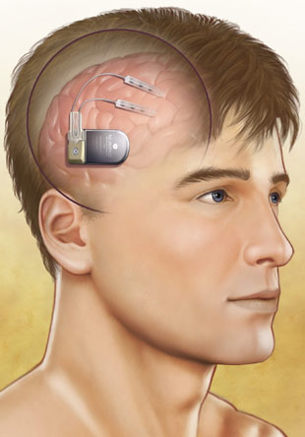
Outcomes…
Surgery is irreversible and chance of seizure control is 30-70%
Failures are due to challenges in localizing the EZ
Neurostimulation: implants placed in or near EZ to use electrical signals to control seizures
reversible - likely wider acceptance
still requires localizing EZ
Notes:
Remove a portion of the skull and expose the brain
Clinical teams needs several seizures to have any confidence that they have a” chance” at localizing the EZ

Slide 11
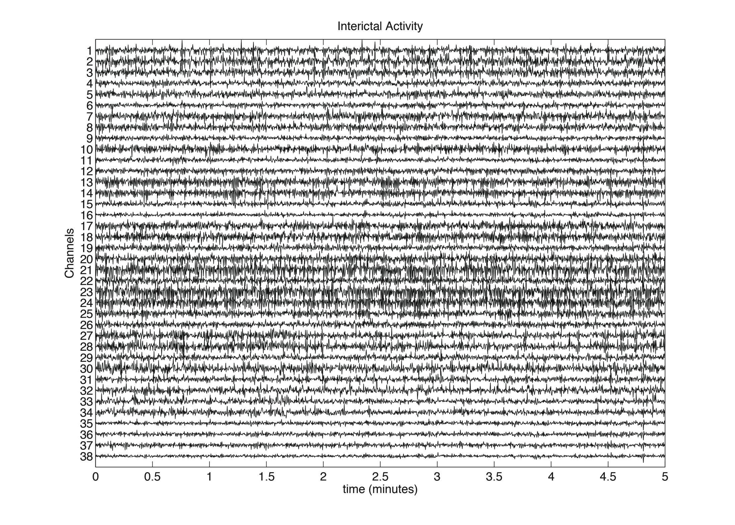
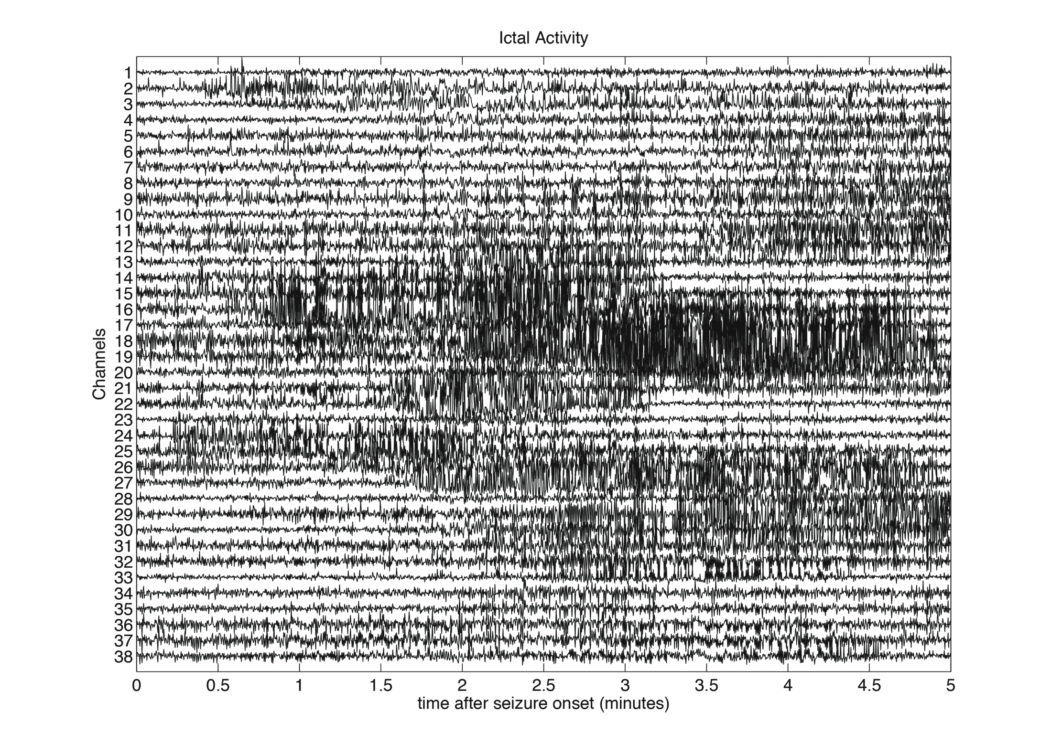
Intracranial eeg gives opportunity to study epileptic network
Non-Seizure
Seizure

Slide 12
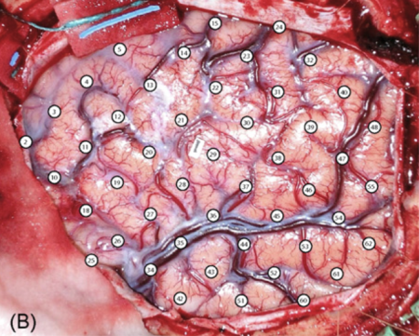
The structure of the epileptic network
We can view a window of the time series as
a graph:
nodes = electrodes
edges exist of signal pairs are correlated

Slide 13
Sparse correlations in non-seizure state

Slide 14
Dense correlations in seizure state

Slide 15
Are there more states? How and when do transitions occur?
?

Slide 16
Look at principal direction of correlation matrix (graph) over time…
One-dimensional approximation of correlation data

Slide 17
Eigenvector centrality interpretation
Each node’s centrality, x, is the sum of
the centrality of his/her neighbors:
_{x(1)}
_{x(2)}
1
2
_{x(4)}
_{x(3)}
4
3
_{x(5)}
5
6
_{x(6)}

Slide 18
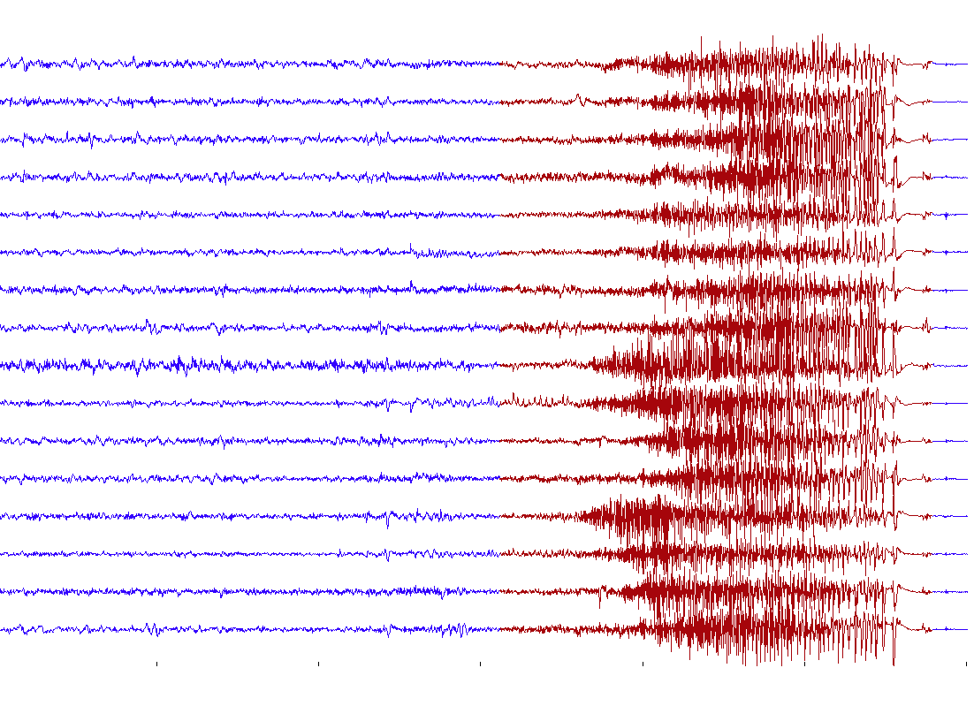
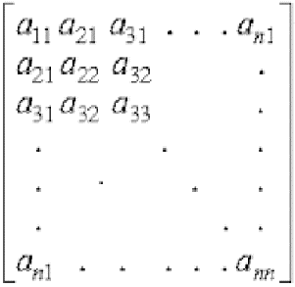
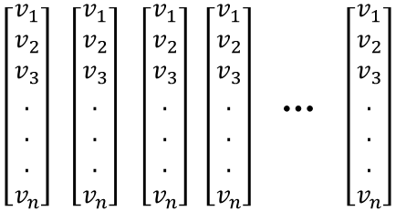
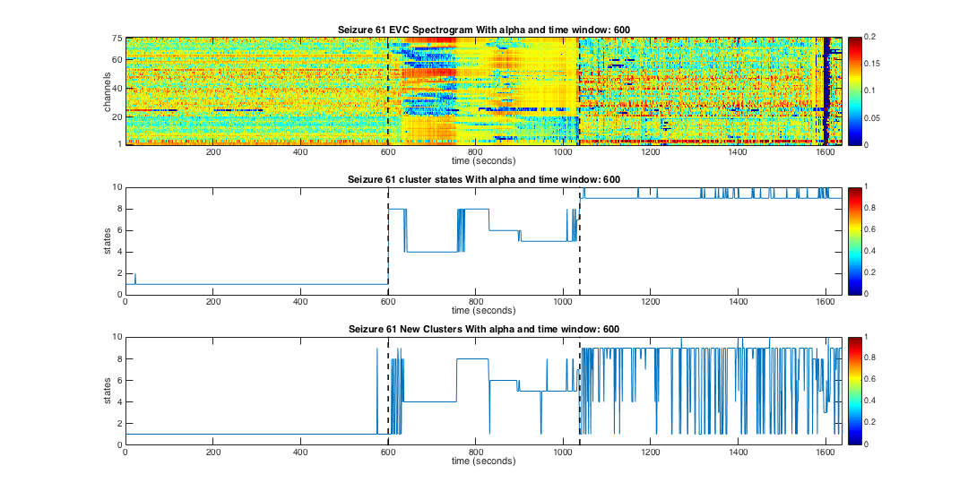
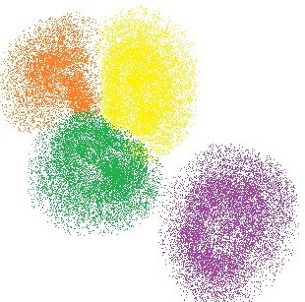
State (structure) detection analysis
network observations
correlation structure over time
………….
2.5 s
“brain state” transitions over time
1D approx. of correlation structure over time
cluster membership
clustering
1
2
4
3

Slide 19
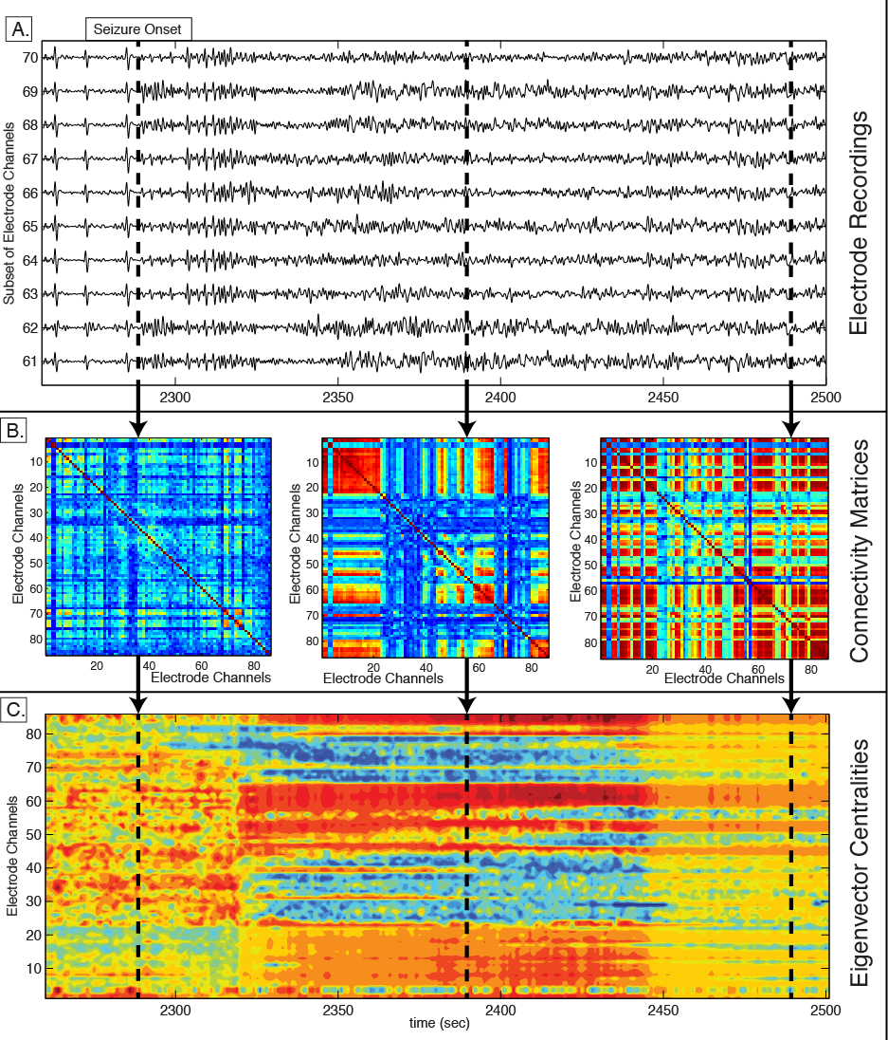
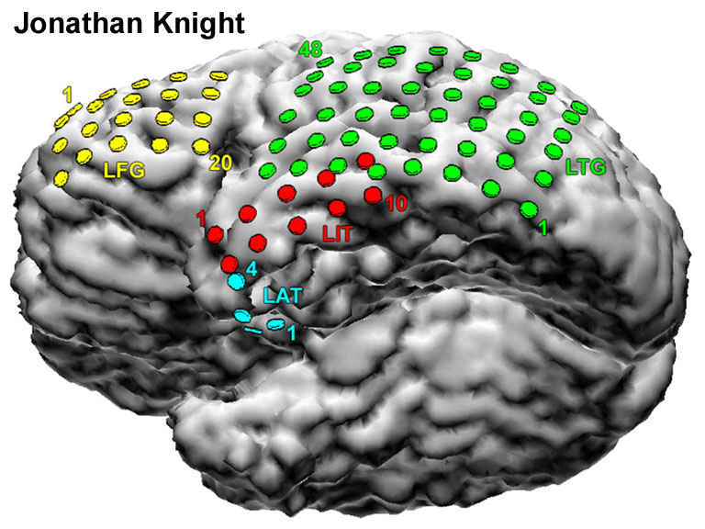
correlation matrices
principal vectors

Slide 20
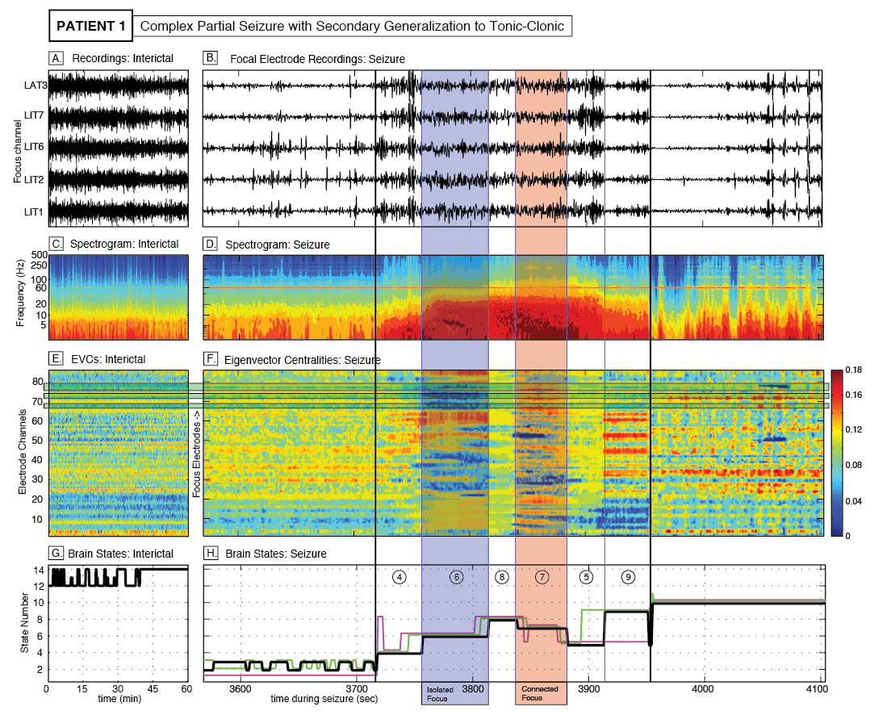
brain state
transitions

Slide 21
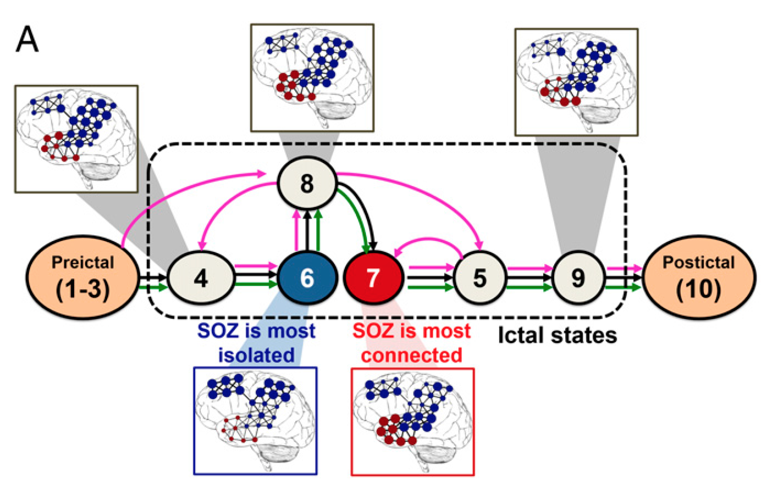
Brain state evolution diagram

Slide 22

EEG “signature” of SOZ?
most
connected
Sequence of principle vectors v(t)
least
connected

Slide 23


Electrode signatures in 2D space

Slide 24


Assign weight to each electrode based on signature

Slide 25
Assign weight to each electrode
“low” likelihood of
being in SOZ
“high” likelihood of
being in SOZ

Slide 26

EZTrack – an assistive tool for SOZ localization
Red shows EZ
EEG
EZMap
EZTrack
Spectral Network Analysis
…..to model the electrodes as a network vs. electrodes in isolation
Temporal Dynamics
…..to measure evolution of correlation structure over time
Pattern Recognition
…..to identify the subset of electrodes that exhibit a marker
Bayesian Statistics
…..to assign a probability of each electrode being in the EZ

Slide 27


Patient cohort and cross-validation of EZTrack
EEG
42 (25 S, 17 F)
iEEG/ECoG
20 (10 S, 10 F)
sEEG
22 (15 S, 7 F)
Occipital
8 (4 S, 4 F)
Temporal
15 (8 S, 7 F)
Occipital
7 (4 S, 3 F)
Temporal
18 (13 S, 5 F)
For each patient cohort: leave one patient out to test ; train EZTrack parameters on remaining patients; predict outcome of test patient

Slide 28

Predicting surgical outcome: compare EZMap’s ROI to Resected Region (RR)
RR
ROI
No overlap
J = 0
Partial overlap
J = 0.33
50-50 Split
J=.25
Strict Superset
J=.6
Complete Overlap
J=1

Slide 29
Predicting surgical outcome: compare EZMap’s ROI to Resected Region (RR)
: threshold for including electrode in ROI
: threshold for predicting success
If then predict success, else failure.

Slide 30
EZTrack works, with 95% accuracy in a retrospective study on 42 patients…
Number of Surgeries
EZTrack Prediction Accuracy
Successful Outcomes
25
23 / 25
(92%)
Failure Outcomes
17
17 / 17
(100%)
Total Surgeries
42
40 / 42
(95%)

Slide 31






EZTrack results
Resected region
EZMap “Hot” region
SUCCESSFUL
OUTCOMES
FAILURE
OUTCOMES
Mis-localization
Misplacement of electrodes
Notes:
Current practice is…clinicians examining manually…its not quick, not easy..is it accurate?
I will talk about 2 tools in a minute
Ours is accurate, quick, …..
Competition is the status quo…no system out there that automatically identifies the EZ..there are systems that
Mathematical model that characterizes how the scalp filters the signals…

Slide 32
Towards commercialization…
Incorporated Neurologic, LLC.
Recruited board of advisors
Raised money
Hired developer
Developing prototype at 3 epilepsy centers
Initiated conversations with EEG companies
Natus
Blackrock Microsystems
Persyst
Waiting for clinical feedback after prototypes launch….

Slide 33


Research scientists
Sam Burns

Slide 34


Research scientists
Bhaskar Chennuri

Slide 35



Acknowledgements
Collaborators
Nathan Crone, MD
Stan Anderson, MD, PhD
John T. Gale, PhD
Jorge Martinez-Gonzalez, MD, PhD
Juan Bulacio, MD
Funds
BWF CASI
NSF PECASE
Coulter Foundation
Maryland Innovation Initiative (MII)

